Slide 1
Bugema University Biometric Class Attendance Tracking System
By
Kibalama Paul
&
Akatwijuka Elia
Kibalama Paul And Akatwijuka Elia

Slide 2

Introduction to BCATS
Enhancing attendance accuracy and security with biometric technology
The Biometric Class Attendance Tracking System (BCATS) revolutionizes attendance management by eliminating manual errors and enhancing security. By utilizing biometric technology, BCATS ensures precise attendance tracking while offering a seamless experience for both students and educators. This innovative approach supports academic integrity and promotes a more efficient learning environment.

Slide 3

Importance of Attendance Management
Enhancing student engagement and accountability in educational institutions
Effective attendance management plays a crucial role in academia by fostering student accountability and promoting engagement. It not only aids in tracking attendance trends but also provides valuable insights into student behavior and performance. By adopting efficient attendance systems, institutions can enhance learning outcomes and encourage a more committed academic environment.

Slide 4

Limitations of Manual Attendance
Addressing the challenges of traditional attendance tracking methods in academia
Manual attendance methods often lead to inaccuracies and inefficiencies. Students may forget to sign in, while others may sign in for their peers, resulting in unreliable data. Additionally, collecting and processing attendance records can be time-consuming, making it difficult for educators to monitor attendance trends effectively.

Slide 5
Problem Statement and Objectives

Slide 6

Problem Statement
Addressing Inefficiencies and Security Concerns in Attendance Management
The current, predominantly manual attendance management system at Bugema University is severely hindering academic operations. Its reliance on paper-based and simple digital records leads to significant time inefficiency, consuming up to 15 minutes of vital instructional time per session. Critically, the manual process is highly susceptible to human errors and lacks effective identity verification, resulting in unreliable records and enabling widespread proxy attendance. Furthermore, the system prevents real-time monitoring and makes report generation difficult and slow. These operational and security flaws collectively undermine the integrity of student engagement data, compromise academic planning, and urgently necessitate the adoption of a secure, accurate, and automated solution.

Slide 7
Project Objectives
Defining aims and specific goals clearly
Main Objective
Specific Objectives
The main objective of this project is to develop the Biometric Attendance Tracking System (BCATS), which aims to enhance attendance management in Bugema University, improving accuracy and efficiency while reducing manual errors and security risks associated with traditional methods.
The project includes specific objectives such as implementing a user-friendly interface for students and staff to interact seamlessly with the system, ensuring data security through encrypted biometric templates, and utilizing real-time data analytics for attendance monitoring to foster accountability and transparency within the academic environment.

Slide 8

Research Questions
Defining the focus and direction of our project research
What are the specific requirements for a biometric attendance system from the perspectives of lecturers, students, and administrators at Bugema University?
How can facial recognition technology be effectively integrated into an attendance management system while ensuring accuracy and user acceptance?
What system architecture and database design would best support the biometric attendance management requirements?
What security measures are necessary to protect biometric data and ensure system integrity?
How does the proposed system compare with traditional attendance methods in terms of efficiency, accuracy, and user satisfaction?
improvements.

Slide 9

Scope of Study
The scope of this project is strictly confined to the design, development, and initial evaluation of a Web-Based Biometric Class Attendance Tracking System (BACTS) for Bugema University, specifically implemented at the Main Campus. The project focuses on core functionalities necessary for effective attendance tracking, including user registration and authentication for lecturers, session creation, and real-time facial recognition for student attendance verification. The system's output will provide basic analytical dashboards for lecturers and administrators at the main campus for internal monitoring.
Limitations and Exclusions:
System Implementation: The system is implemented as an initial standalone web application; therefore, dedicated mobile application development is excluded from this scope.
Data Integration: While the system utilizes a relational database for data storage, integration with the main University ERP will be limited to basic data import/export functions until dedicated APIs become available.
Biometric Technology: The biometric technology is strictly limited to facial recognition using standard web cameras. Fingerprint scanning or other hardware-based biometric methods reserved for future enhancements.

Slide 10
Project Significance Overview

Slide 11

Significance of BCATS
Enhancing academic attendance through efficiency, security, and innovation
Strategic Pillar | Key Benefits
I. Operational Efficiency & Time Savings | 70% Time Reduction: Frees up instructional time by automating attendance taking. Scalability: Effortlessly accommodates growing student enrolment without increasing administrative load. Environmental: Supports sustainability by eliminating paper consumption.
II. Data Integrity & Security | Eliminate Fraud: Facial Recognition technology completely prevents proxy (fake) attendance. Accuracy: Automated recording eliminates human error in data collection and transcription. Regulatory Compliance: Ensures verifiable, secure records for accreditation and audit purposes.
III. Strategic Decision Making | Real-time Intervention: Provides immediate access to attendance data for timely student follow-up. Data-Driven Insights: Analytics features help identify critical student attendance patterns.

Slide 12

Literature Review
Analyzing Current Trends in Attendance Systems and Biometric Technologies
The integration of biometric technologies in attendance systems is rapidly evolving. Recent studies highlight the advantages of automated solutions over traditional methods, showcasing increased accuracy and efficiency. This literature underscores the importance of adopting these systems in educational institutions to enhance management and security.

Slide 13

Data Collection Techniques
Utilizing interviews, surveys, and observations for effective insights
Primary Data Collection
Interviews (Semi-structured):
3 administrative staff
15 students across various programs
Focus: Current challenges, desired features, usability preferences
Observation:
Direct observation of current attendance processes in 10 classes
Time-motion studies to quantify time spent on attendance activities
Environmental assessment of classrooms for biometric implementation
Document Analysis:
Existing attendance records and reporting formats
University policies on attendance management
Technical infrastructure documentation
Questionnaire Survey:
Distributed to 50 lecturers and 200 students
Likert-scale questions on system requirements
Open-ended questions for qualitative insights
Secondary Data Collection
Literature Review: As detailed in Chapter 2
System Analysis: Examination of provided interfaces and similar commercial systems
Technical Specifications: Review of biometric hardware and software options
Regulatory Framework: Analysis of data protection laws and educational regulations

Slide 14

Agile-Scrum Methodology
Utilizing Agile-Scrum for iterative development and continuous improvement in BCATS
The Agile-Scrum methodology fosters collaboration and flexibility while developing BCATS.
By breaking the project into manageable sprints, we adapted to changes quickly and incorporated feedback effectively.
This approach ensures that the final product meets user expectations and improves overall quality through iterative testing and refinement.

Slide 15
Testing
Understanding Unit, Integration, System, and UAT Testing Methods
This chapter details the implementation process of the Biometric Attendance Management System using Convex as the reactive backend platform.
It covers the tools and technologies employed, module implementation specifics, code architecture, and comprehensive testing strategies. The implementation follows an iterative Agile approach with continuous integration and real-time feedback loops enabled by Convex's reactive architecture.

Slide 16
System Architecture Overview of BCATS
System Components
This diagram highlights the key structural elements involved.

Slide 17
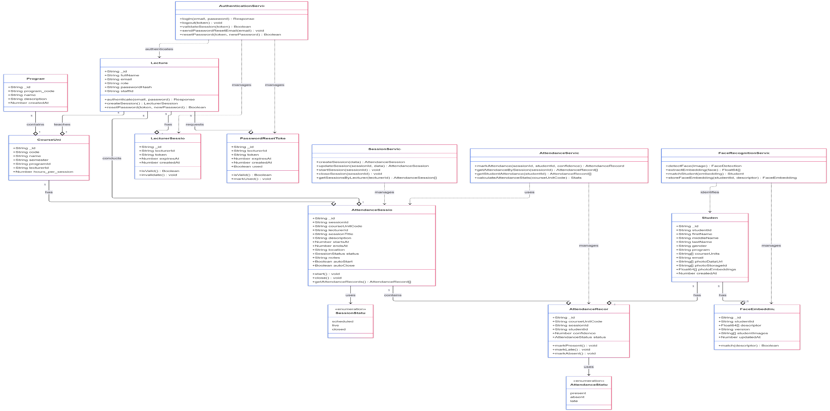
CLASS DIAGRAM

Slide 18
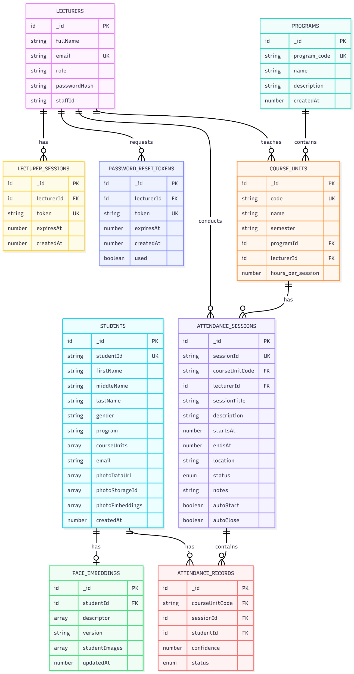
ERD

Slide 19

Frontend Technology
Utilizing React.js for a Dynamic User Experience in BCATS
React.js offers a powerful framework for building interactive user interfaces. Its component-based architecture allows developers to create reusable UI components, facilitating faster development and easier maintenance. By leveraging React.js, BCATS can provide a seamless experience for users engaging with biometric attendance features.

Slide 20

Backend Platform
Exploring the features of Convex serverless real-time database technology
Convex offers a highly scalable and efficient serverless architecture tailored for real-time applications.
It eliminates the complexities of server management, providing seamless integration with frontend technologies.
This ensures rapid data processing and retrieval, allowing for a more responsive user experience in attendance management systems like BCATS.

Slide 21

Biometric Engine
Leveraging FaceAPI.js and TensorFlow.js for Enhanced Recognition
The integration of FaceAPI.js and TensorFlow.js enables sophisticated facial recognition capabilities within BCATS.
This technology allows for rapid, accurate identification of students, streamlining attendance management while maintaining high security.
By harnessing deep learning algorithms, the system efficiently processes images and enhances overall performance.

Slide 22
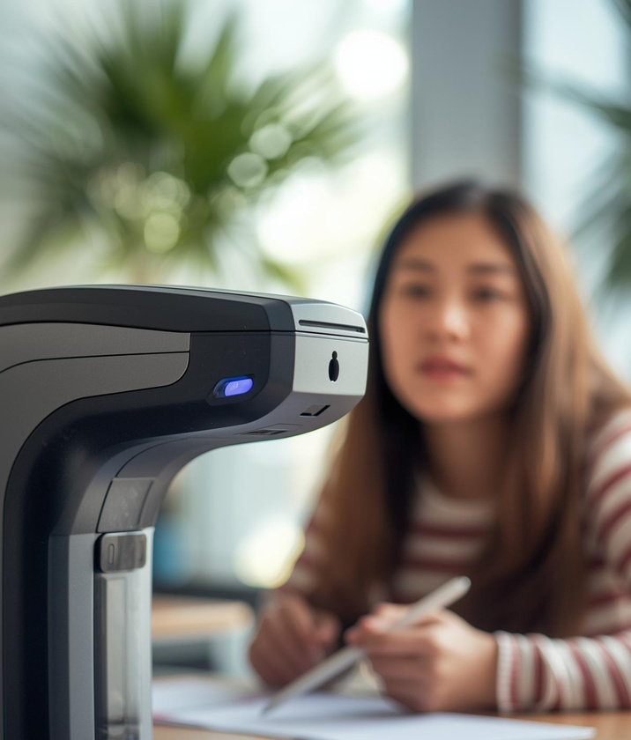


Key BCATS Features
Dashboards
Enrolment
Real-time Recognition
Intuitive interface for monitoring attendance data
Streamlined process for new student registration
Instant attendance verification using biometrics

Slide 23

Development Tools
Overview of frameworks and technologies utilized for project development
Frontend Stack:
React 18 with TypeScript for type-safe development
Tailwind CSS for responsive UI components
Convex React SDK for real-time data synchronisation
FaceAPI.js for client-side facial recognition preprocessing
React Query for additional state management
Backend/Convex Stack:
Convex Platform (TypeScript runtime)
Convex Database with reactive queries
Convex File Storage for biometric templates
Convex Vector Search for facial recognition matching
Convex Scheduled Functions for automated tasks
Convex Actions for external API integrations
Development Tools:
VS Code with Convex extension
Git & GitHub for version control
Postman for API testing
Docker for consistent development environment
Biometric Processing:
TensorFlow.js for neural network operations
FaceAPI.js models (TinyFaceDetector, FaceLandmark68Net, FaceRecognitionNet)
WebRTC for camera access
Canvas API for image processing

Slide 24
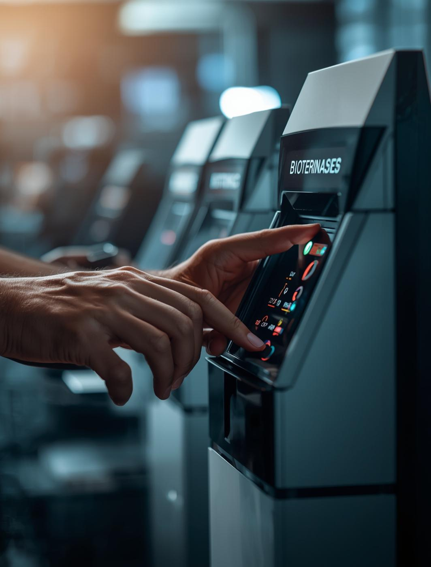
Technical Challenges
Overcoming obstacles in biometric attendance system implementation and usage
During the development of BCATS, we faced several significant challenges including
slow recognition speeds,
inconsistent lighting, and
connectivity issues.
By implementing advanced algorithms for image processing and optimizing network configurations, we successfully enhanced performance, ensuring a seamless user experience for both lecturers and students during attendance verification.

